Slide 1
Weekly report: Electrical Drivetrain
Week number: 13
Date: 23/12/2025
Supervisor: Prof. Dr.-Ing. Saiju
Group members: Aiswarya Vijayan, Vishranti Shivajirao Patil , Girish Mahadeo Padalkar, Cristina Milene Vergara Hernandez

Slide 2
List of contents
Mechanical Dimension of Transformer(updated).
Mechanical Dimension of Generator(Updated).
Mechanical Dimension of Converter(Updated).
Cable selection and electrical parameters.
Electrical Drivetrain/ Optimus Syria

Slide 3
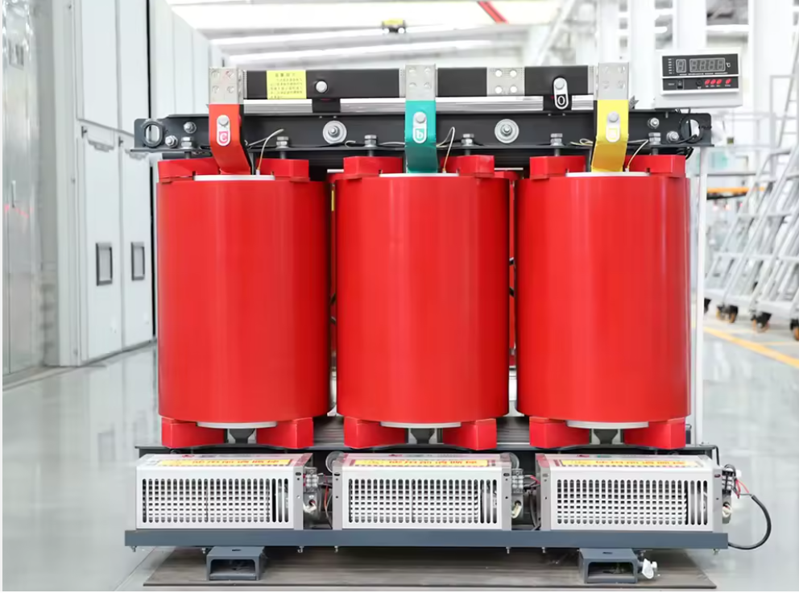
1. Mechanical Dimension of Transformer.(Updated)
2700 * 1270 * 2550mm | Converter Dimensions (LxHxW)
~10500 kg | Weight
Cast resin dry type transformer | Cooling
99.0% | Efficiency
€ 60,000 – 90,000 | Cost

Slide 4
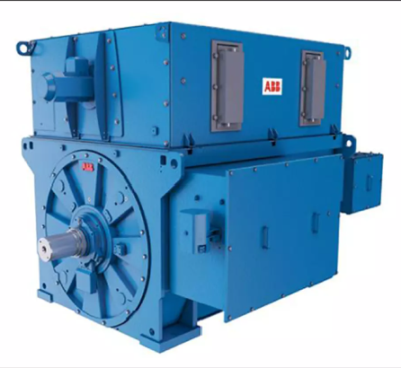
2. Mechanical Dimension of Generator.(Updated)
3500 * 1700 * 2000mm | Converter Dimensions (LxHxW)
20.9 T | Weight
Force Oil circulation | Cooling
97.0% | Efficiency
€154,800 | Cost

Slide 5
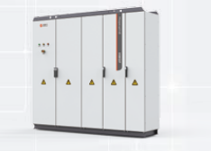
3. Mechanical Dimension of Converter.(Updated)
2600 * 2000 * 600mm | Converter Dimensions (WxHxD)
~1600 kg | Weight
Air Cooling | Cooling
98.0% | Efficiency
€37,500 | Cost

Slide 6
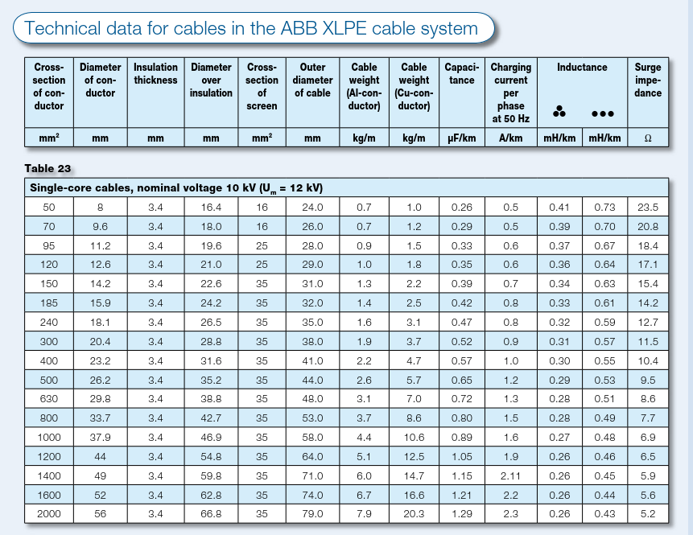
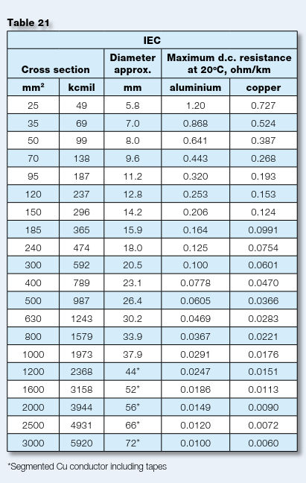
4.Cable Selection and Electrical Parameters

Slide 7
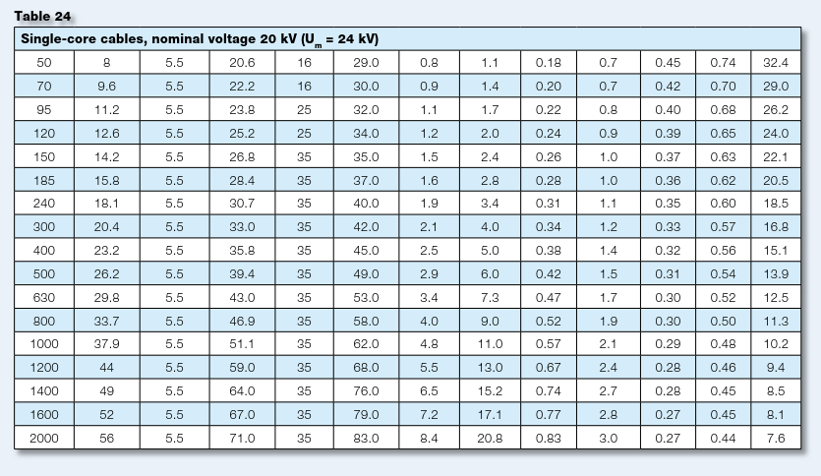


Slide 8
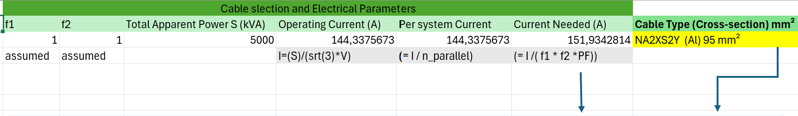
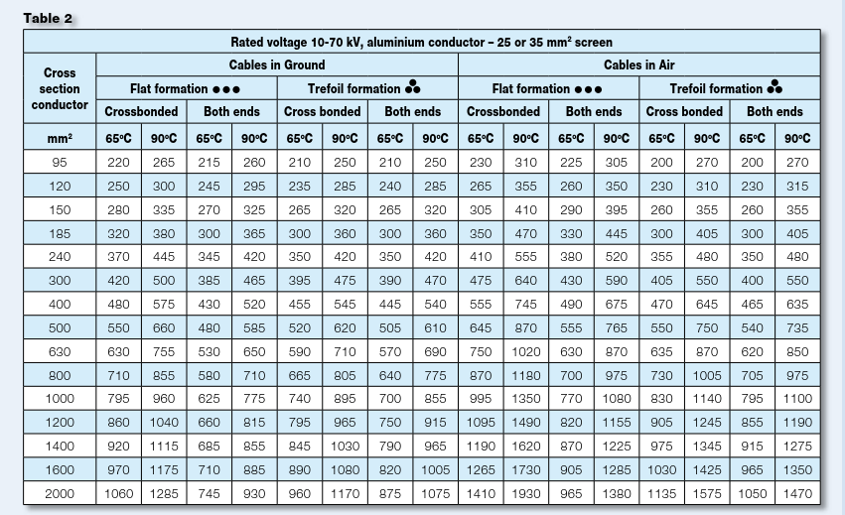
Grid side control scheme . Source [own]. 06.12.2024

Slide 9

Bibliography
1. Electrical machines and power electronics course Prof.Dr.-Ing Rajesh Saiju,
2. Electrical engineering for wind turbines course of Prof. Dr. Ingmar Leise.
3. Hopewind Electric Co., Ltd., “Wind Power Generation System Product Catalog,” Nov. 2022. [Online]. Available: https://pt.hopewind.com/bocupload/2022/11/24/166926457699or15g.pdf
4.ACS800_LOW_VOLTAGE_WIND_TURBINE_CONVERTERS.pdf [Online].
5. SGB – Cast –Resin_Transformers [Online]
23/12/2025
9

